Slide 1


Supporting Big Emotions
Gareth Jones Emotional Health and Wellbeing Specialist Teacher
Gareth.Jones17@cardiff.gov.uk

Slide 2
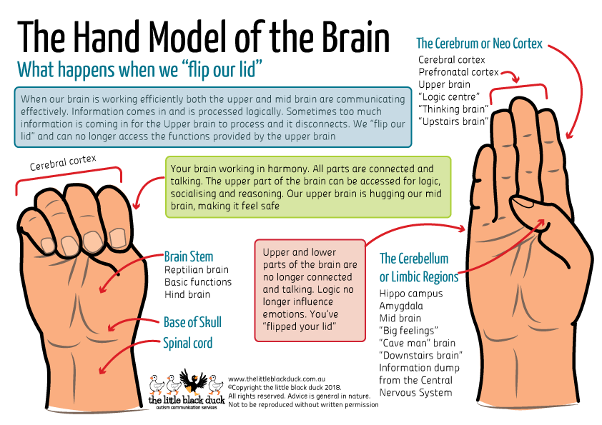
Slide 1.9
Notes:
Faced with same situation , some will feel angry and others will not. Some will show how they feel, others will not... See later slide.
Responses can vary according to gender, age, ethnicity, religion, social position or family history- give some e.g’s
It is thought unacceptable by some for women to shout in anger...
We have a number of “learnt behaviours” that form a pattern that is hard to break. Parents can influence how their children react.
People think anger and aggression are the same but research estimate sonly about 105 of angry people become aggressive. Anger is the emotional state and aggression is the behaviour .Aggression takes over the thinking brain and operates only with the feeling part- both drugs and alcohol can lower our inhibitions.

Slide 3
Supporting Big Emotions
Effects on the body | Effects on the mind
a churning feeling in your stomach tightness in your chest an increased and rapid heartbeat legs go weak tense muscles you feel hot you have an urge to go to the toilet sweating, especially your palms a pounding head shaking or trembling dizziness | feeling tense, nervous or unable to relax feeling guilty feeling resentful towards other people or situations you are easily irritated 'red mist' comes down on you feeling humiliated Feeling irritable

Slide 4
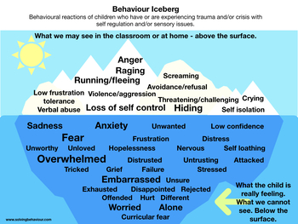

Slide 5
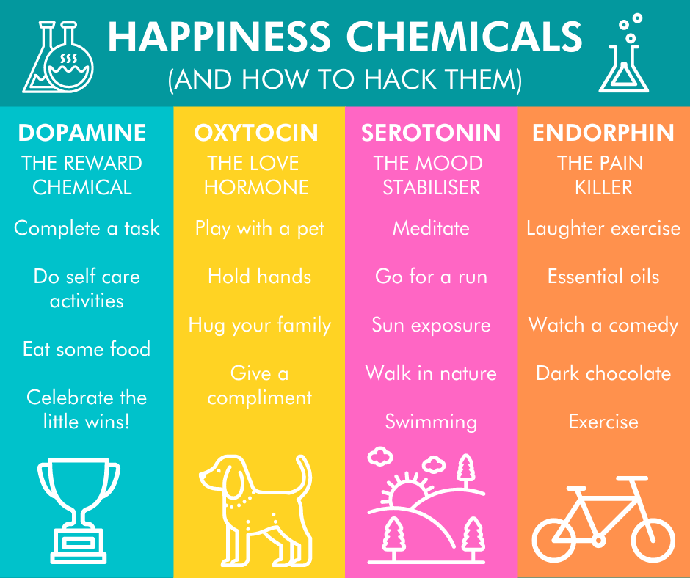

Slide 6
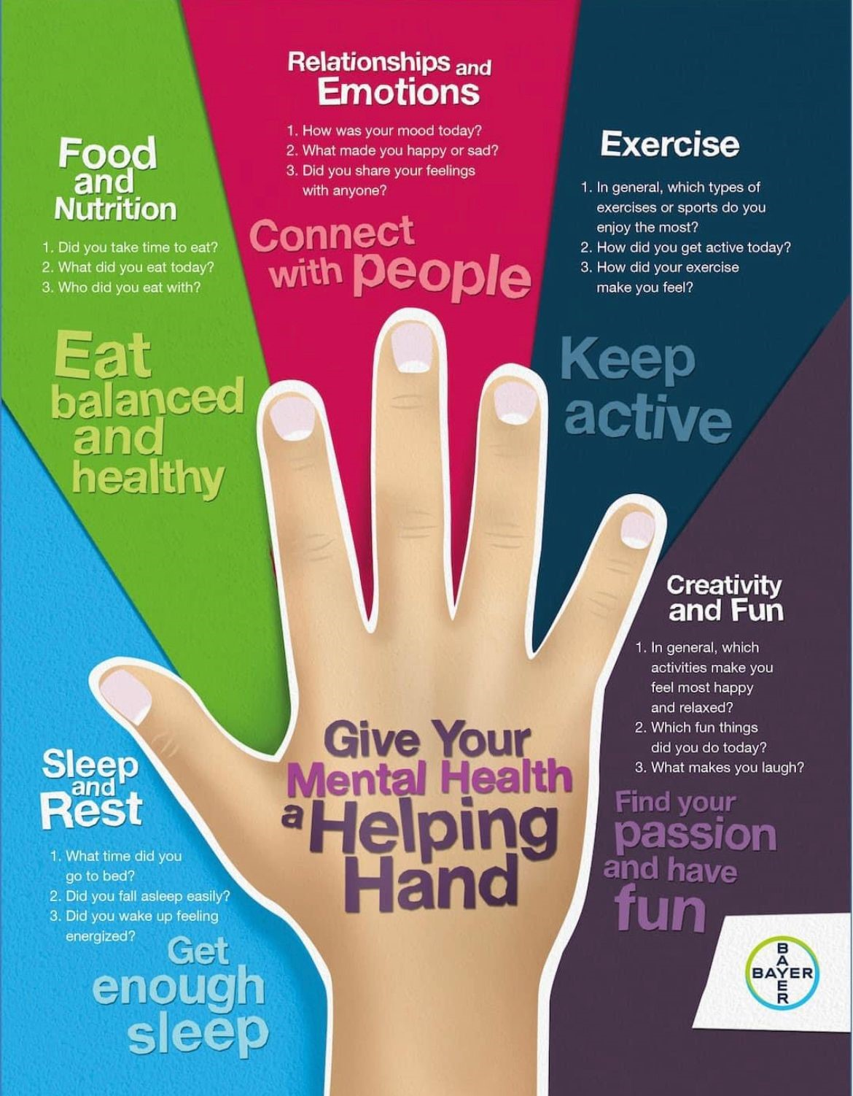

Slide 7

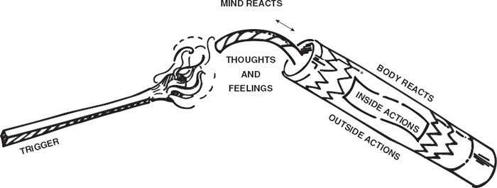
The Firework Model
Notes:
Three components
The Trigger - the match that ignites the fuse & leads to thoughts and feelings
The Fuse - is the mind reacting & causing thoughts /feelings (e.g. fear or threat)
The Explosive Firework - the cylinder is the body responding physiologically…& may lead to anger

Slide 8
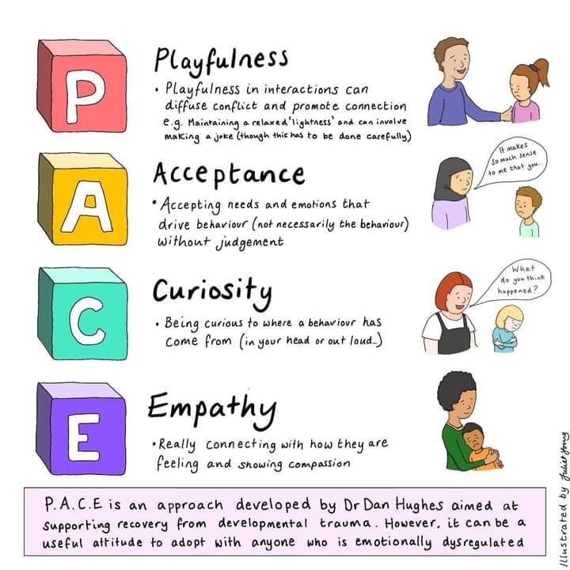

Slide 9
W | I wonder | I wonder if you are feeling angry because
I | I imagine | I imagine that you are finding x really difficult
N | I notice | I notice that you clench your fists when x

Slide 10
Positive language and phrases that help convey attunement
I wonder….
I imagine…….
I notice……
I can see you’re finding this difficult right now.
It’s ok to feel like this.
That was really hard for you.
Let’s see….
Shall we do it together, you and I?
Tell me if I’m wrong.
It’s really hard for you isn’t it?
What I know about you is….you like/don’t like……
Wow, I don’t even know what to say right now that must be so hard for you.
That’s huge for you, isn’t it?
I imagine you are feeling so sad.
That’s such a big thing for you.
I’m going to check in with you.
Wow, I can see that’s really big for you.
I’m just wondering, if you feel like that again what can we do for you?
I can see you are dealing with big feelings.
I can see you are not ready right now.
I am keeping you safe.
Kind words please.
No thank you
Well done you are using your words
We know you are there; we haven’t forgotten you.
I like how you….
I can see you are …., I wonder if it is because…..
You could do it with …. or …..
You could do it now or in …. minutes.
You can do …. or …., your choice.
You can trust the adult to sort this out.

Slide 11
Self regulation
Self regulation skills include:
The ability to understand and manage emotions
Understanding your own stress response - and then managing your behaviour in a positive way
Learning how to control impulses
Being able to not over-react when upset or excited
The ability to calm down after an incident
Co regulation
You and the child participate together in calming activities, and your child absorbs some of your calmness. This might include reading a book before bedtime, taking deep breaths together when upset, or sharing a deep squeeze hug. These activities also develop bonding and trust.
Some pupils have not experienced co-regulation with an adult and may struggle to a greater extent to regulate their emotions. They will likely need additional help from adults to ‘co-regulate’ for longer. We would always advise for these regulating activities to be modelled by an adult alongside the pupils, until they have learnt the skills to ‘self-regulate’

Slide 12
A dysregulated child needs the support of a regulated adult. We have to act as their external regulatory system.
A dysregulated adult cannot hope to help regulate a child.

Slide 13
De-escalation & de-fusing
Ensure that your emotions are regulated
Avoid making demands
Use a neutral tone of voice
Use neutral / non threatening body language
Focus on safety and containment
Validate their feelings
Separate the child from the behaviours
Consider personal space
Get down the child’s level
Meet their basic needs
Decrease distractions and stimulation
Ignore targeted aggression
Don’t feel the need to fill the silence

Slide 14
